Slide 1
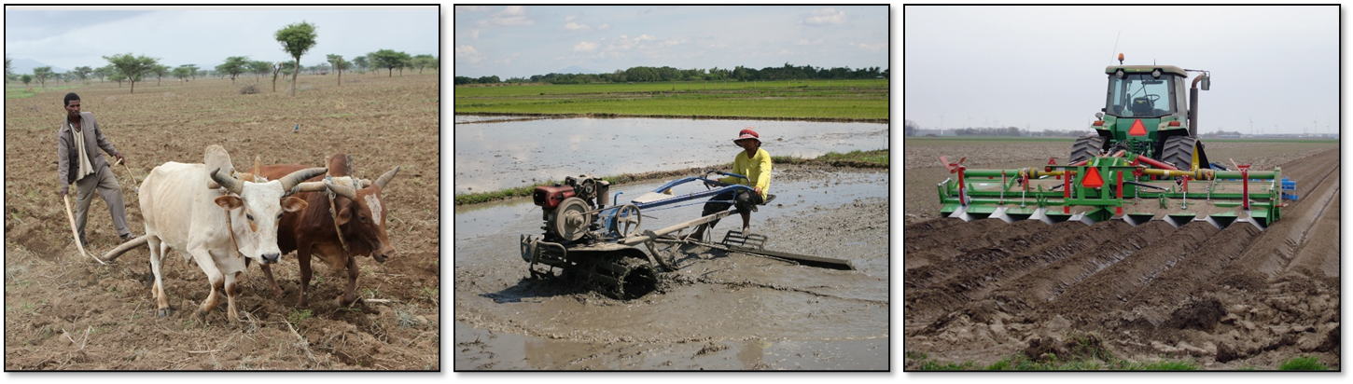
Yield gap decomposition: Theory & practice
João Vasco Silva (PhD)
j.silva@cgiar.org
Agronomy-at-scale Data Scientist
CIMMYT-Zimbabwe
Addis Ababa, May 24th 2023

Slide 2
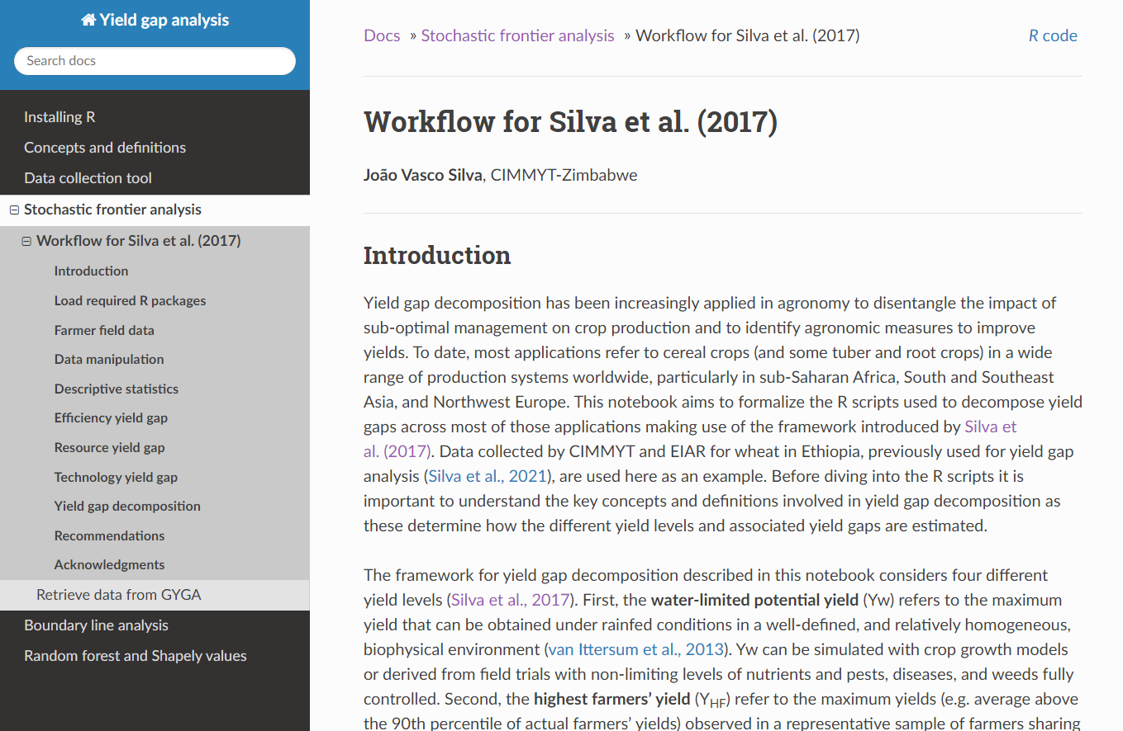
https://jvasco323.github.io/eia-yg-training

Slide 3
Efficiency yield gap and Y_{TEx}
Yw
Y_{HF}
Technology
yield gap
Y_{TEx}
Resource
yield gap
Crop yield (t/ha)
Ya = actual farmers’ yields
- Farm household surveys
Y_{TEx} = technical efficient yields
- Stochastic frontier analysis
Y_{HF} = highest farmers’ yields
- Top 10th percentile of Ya
Yp = water limited potential yield
- Global Yield Gap Atlas
Efficiency
yield gap
Ya
Input use (e.g., kg N/ha)
Silva et al. (2017) Eur. J. Agronomy

Slide 4
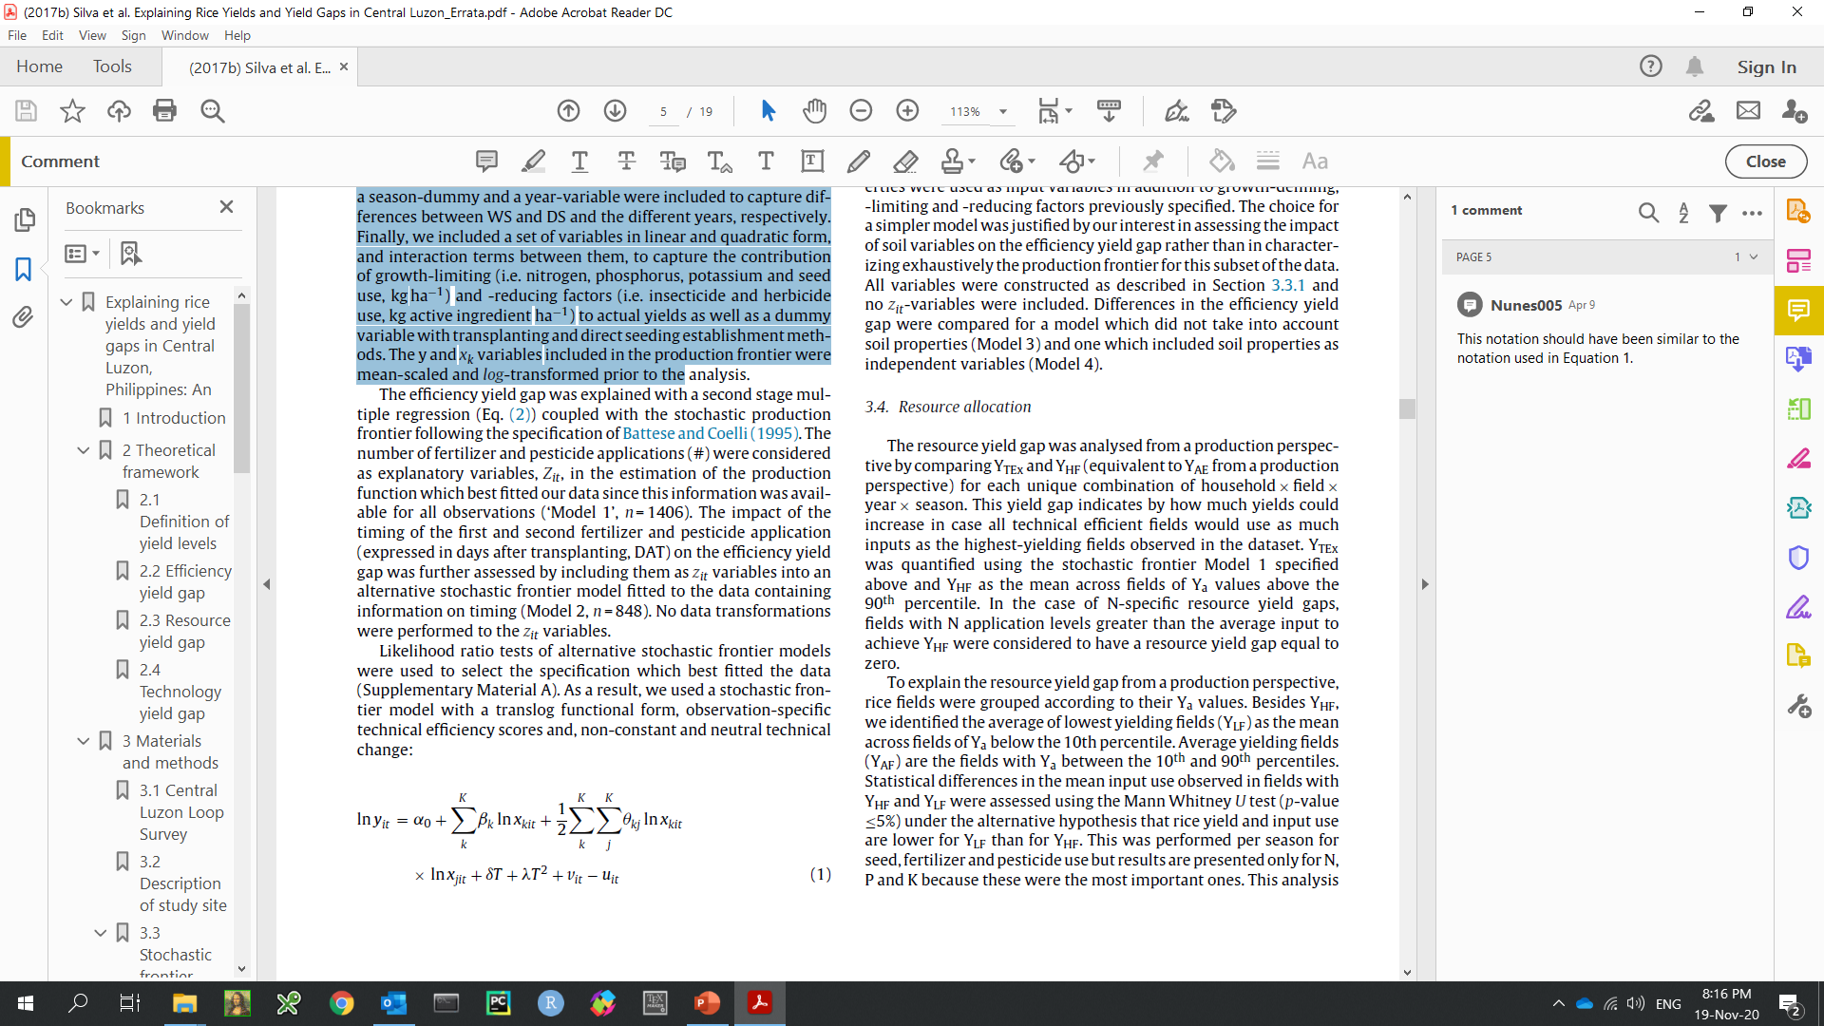
Stochastic frontier analysis
SFA is a parametric method for technical efficiency analysis that differentiates two error terms (random noise, v, and technical inefficiency, u).
Technical efficiency measures the effectiveness of converting inputs to outputs. TE = 1 implies that maximum output is produced per unit input.
Econometric method developed and widely applied by economists. But also used in many other disciplines.
Applied to individual firms (e.g., farms, factories, banks, etc.) to understand the scope for improving performance and efficiency of production.

Slide 5
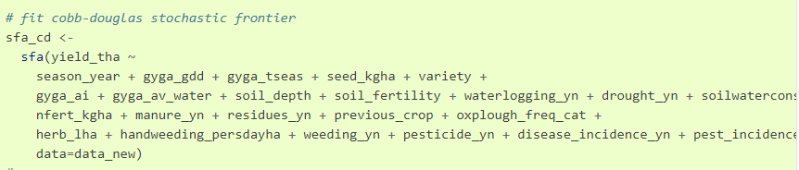
Stochastic frontier analysis in R
Start always with lm() and check R², residuals and multi-collinearity (VIF).
sfa() function of the R package frontier.
Battese & Coelli models:
Single-output multiple-input frontier;
1992 model: Cross-section vs. panel data;
1995 model: Single step estimation of frontier & inefficiency effects;
Functional forms: Cobb-Douglas vs translog.
Control for climate, soil, and varieties, so yield gaps are due to management only.
Decide on variables for production frontier vs. inefficiency effects.

Slide 6
Resource yield gap and Y_{HF}
Yw
Y_{HF}
Technology
yield gap
Y_{TEx}
Resource
yield gap
Crop yield (t/ha)
Ya = actual farmers’ yields
- Farm household surveys
Y_{TEx} = technical efficient yields
- Stochastic frontier analysis
Y_{HF} = highest farmers’ yields
- Top 10th percentile of Ya
Yp = water limited potential yield
- Global Yield Gap Atlas
Efficiency
yield gap
Ya
Input use (e.g., kg N/ha)
Silva et al. (2017) Eur. J. Agronomy

Slide 7
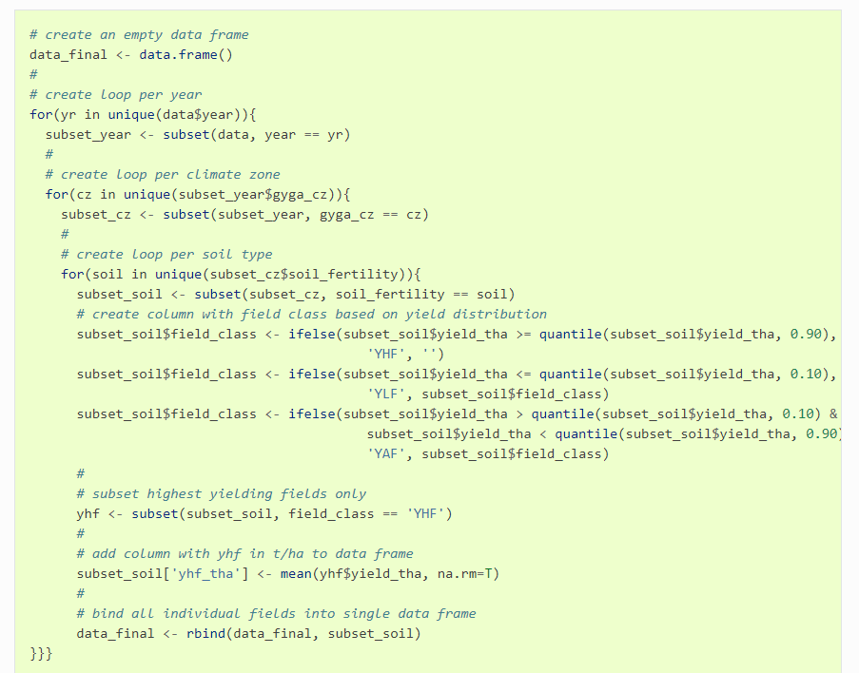
Quantiles within ‘for loop’ in R

Slide 8
Technology yield gap and Yw
Yw
Y_{HF}
Technology
yield gap
Y_{TEx}
Resource
yield gap
Crop yield (t/ha)
Ya = actual farmers’ yields
- Farm household surveys
Y_{TEx} = technical efficient yields
- Stochastic frontier analysis
Y_{HF} = highest farmers’ yields
- Top 10th percentile of Ya
Yp = water limited potential yield
- Global Yield Gap Atlas
Efficiency
yield gap
Ya
Input use (e.g., kg N/ha)
Silva et al. (2017) Eur. J. Agronomy

Slide 9
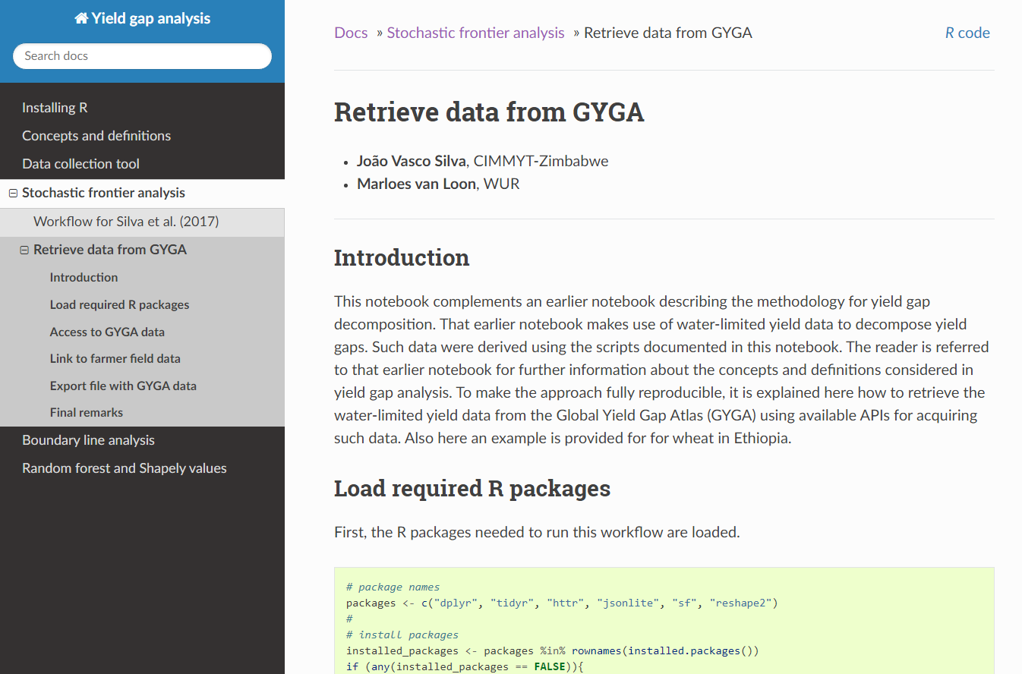
Global Yield Gap Atlas in R

